Slide 1
UNIT-5
Java script

Slide 2
What is Scripting Language?
A script is a program or sequence of instructions that is interpreted or carried out by another program rather than by the computer processor.
A scripting language or script language is a programming language that supports scripts, programs written for a special run-time environment that can interpret (rather than compile) and automate the execution of tasks.
Scripting languages, which can be embedded within HTML, commonly are used to add functionality to a Web page, such as different menu styles or graphic displays or to serve dynamic advertisements.

Slide 3
Client Side Vs. Server Side Scripting
Server side Scripting | Client Side Scripting
Used to create web pages which provides some services. | Used to create web pages as a request or response to server. These web pages are displayed to user on web browser.
Scripts run in web servers. | Scripts run on web browsers.
Server executes server-side scripts to send out a page but it does not execute client-side scripts. | The browser receives the page sent by the server and executes the client-side scripts
Server side scripting is used to connect to the databases,can access files that reside on the web server. | Client side scripting used for interacting with temporary storage such as cookies or local storage. can`t connect to database or files resides in web server.

Slide 4
Server side Scripting Client side scripting
Response from a server-side script is slower as compared to a client-side script because the scripts are processed on the remote computer. | Response from a client-side script is faster as compared to a server-side script because the scripts are processed on the local computer.
Examples : PHP, JSP, ASP, ASP.Net,C++,JAVA | Examples: HTML,CSS,Javascript

Slide 5
Java Script Introduction
JavaScript ( JS) is a dynamic language.
It is most commonly used as part of web browsers, whose implementations allow client-side scripts to interact with the user, control the browser, communicate asynchronously, and alter the document content that is displayed.
It is also used in server-side network programming with runtime environments , game development and the creation of desktop and mobile applications.

Slide 6
How Does JS Work?
Embedded within HTML page
View source
Executes on client
Fast, no connection needed once loaded
Simple programming statements combined with HTML tags
Interpreted (not compiled)
No special tools required

Slide 7
JavaScript Advantages
More interactive and live website creation
Active user interface
Improved appearance
Site navigation
Perform calculations
Validation of input

Slide 8
How to develop JS?
Use simple editor and browser same as in HTML & CSS.
Also we can use IDEs like Dreamweaver

Slide 9
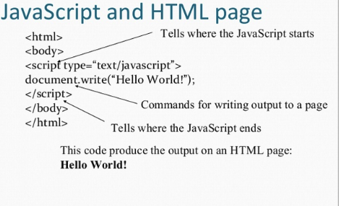
Java script Syntax

Slide 10
Java script Syntax
Unlike HTML, JavaScript is case sensitive.
Dot Syntax is used to combine terms.
e.g ., document.write("Hello World")
Certain characters and terms are reserved.
JavaScript is simple text (ASCII).

Slide 11
Methods
Methods are actions applied to particular objects. Methods are what objects can do.
e.g., document.write(”Hello World")
document is the object.
write is the method.

Slide 12
Java Script in HTML
Scripts in HTML must be inserted between <script> and </script> tags.
Scripts can be put in the <body> and in the <head> section of an HTML page.
The <script> and </script> tells where the JavaScript starts and ends.

Slide 13
How to Insert JS Code
In HTML document can be inserted anywhere, i.e. in HEAD & in BODY.
2 ways to insert JS in HTML page
Embedded
External

Slide 14
1. Embedded
Can be embedded within an HTML document.
< script type=“text/javascript”>
……….
……….
</script>
Also written as
<script language=“javascript” type=“text/javascript”>
….
….
</script>

Slide 15
2. External
<script src=“external2.js”>
</script>

Slide 16
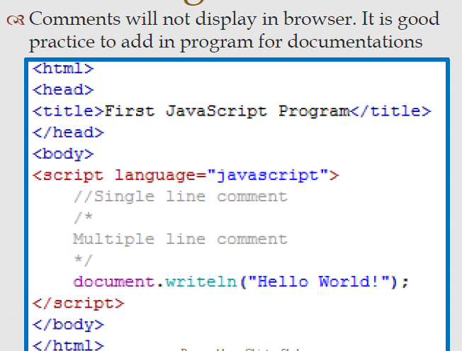
Comment in JS

Slide 17
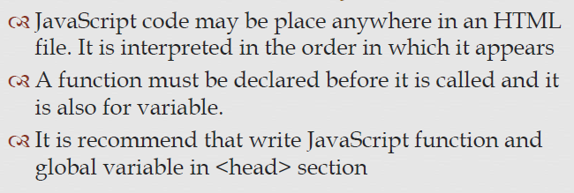
Placement of JS Code

Slide 18
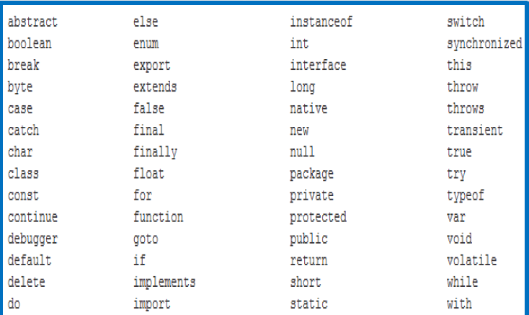
JS Keyword

Slide 19
Basic Programming Technique
The <head> … </head> tag make an ideal place to create JavaScript variables and constants and so on.
This is because the head of an HTML document is always processed before the body.
By using this technique the interpreter will always create functions, constants of structure before using them.

Slide 20
Basic Programming Technique
It is important because any attempt to use a variable or any object before it is defined, results in an error.
Variable name can begin with upper case or lowercase or underscore character or dollar sign character.
The remaining characters can consist of letters, or underscore or digits.
Variable names are case sensitive.
Ex. Sub, sub, SUB all are different

Slide 21
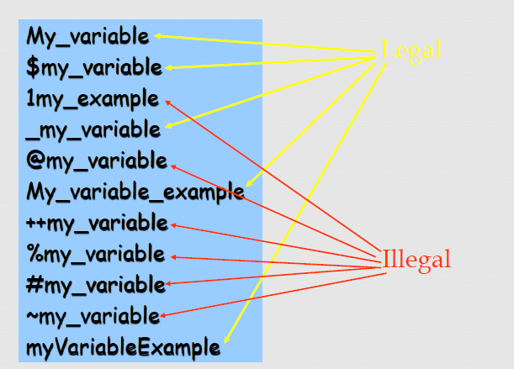
Which one is legal or illegal.

Slide 22
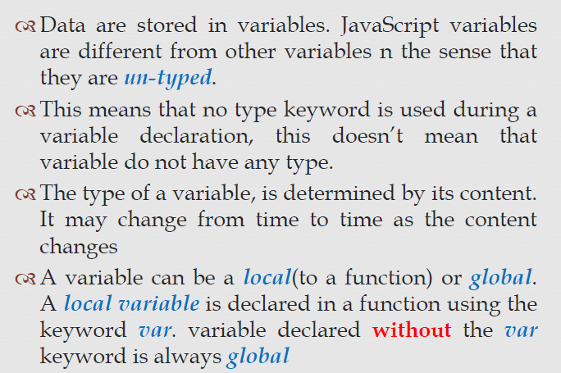
Variables

Slide 23
Variable
Variables contain values and use the equal sign to specify their value.
Variables are created by declaration using the var command with or without an initial value state.
e.g. var month;
e.g. var month = April;

Slide 24
Local Variable
Local variables are declared with in a function.
Syntax:- var name_of_variable=value;
The keyword var specifies the variable is a local variable and visible within the scope in which it is declared
var total=0 //number
var message=“Hello”; //string
var found=false; //boolean

Slide 25
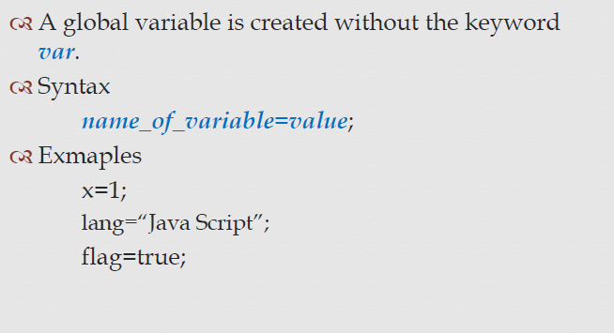
Global variables

Slide 26
Scope
Global or local variable can have either local or global scope.
If a variable is created with var statement such as:
var a; or var a,b,c;
Then the scope will be either local or global depending on where declared.
If a variable is inside a function, it will be local to that function.

Slide 27
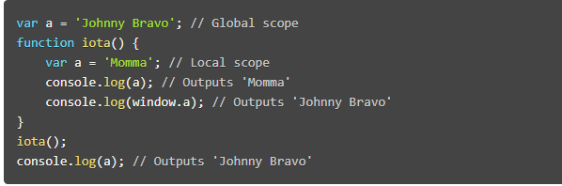
Example

Slide 28
Data Types
There are following types used in Java Script
String
Number
Boolean
Null & Undefined.
Object
Array

Slide 29
Strings
A string is a variable which stores a series of characters like “CE Dept.".
A string can be any text inside quotes. You can use single or double quotes:
var department=“CE Dept";
var department=‘IT Dept’;

Slide 30
Cont’d..
You can use quotes inside a string, as long as they don't match the quotes surrounding the string.
var answer= “ It's alright “;
var answer=“ This subject is ‘WAD’ ";
var answer=‘ This subject is “WAD” ‘;

Slide 31
Boolean
Booleans can only have two values: true or false.
var x=true
var y=false
Booleans are often used in conditional testing.

Slide 32
Null
Undefined is the value of a variable with no value.
Variables can be emptied by setting the value to null;
cars=null;
person=null;

Slide 33
Object
An object is delimited by curly braces. Inside the braces the object's properties are defined as name and value pairs (name : value).
The properties are separated by commas:
var person={firstname:"John", lastname:"Doe“, id:5566};

Slide 34
Object
The object (person) in the example above has 3 properties: firstname, lastname, and id.
Spaces and line breaks are not important. Your declaration can span multiple lines:
var person={ firstname : "John“, lastname : "Doe“, id : 5566 };

Slide 35
Array
The following code creates an Array called cars:
var cars=new Array();
cars[0]=“Audi";
cars[1]=“Jaguar";
cars[2]="BMW";
It can also be declared as:
var cars=new Array(“Audi", “ ”, “Jaguar","BMW");
And even as:
var cars=[“Audi",“Jaguar","BMW"];

Slide 36
Operator
Arithmetic
Assignment
Concatenation
Comparison
Logical
Conditional

Slide 37
Arithmetic
Arithmetic operators are used to perform arithmetic operation between variables and/or values.
Operator | Name | Description | Example
+ | Addition | Adds the operands | 3 + 5
- | Subtraction | Subtracts the right operand from the left operand | 5 - 3
* | Multiplication | Multiplies the operands | 3 * 5
/ | Division | Divides the left operand by the right operand | 30 / 5
% | Modulus | Calculates the remainder | 20 % 5

Slide 38
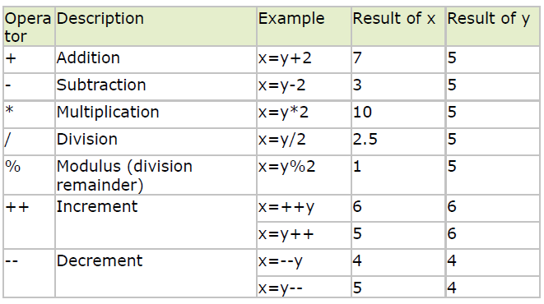
Arithmetic Operator
Given that y=5, the table below explains the arithmetic operators:

Slide 39
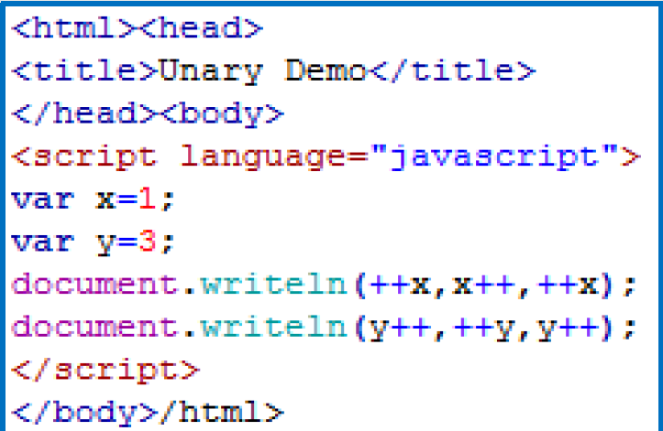
Example

Slide 40
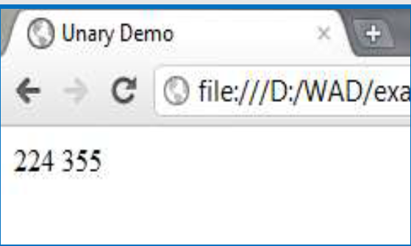
Output

Slide 41
Operator Precedence
Operators having higher precedence are evaluated before operators having lower precedence.
Arithmetic operator precedence
Precedence | Operators
Lowest | +, - *, /,%
Highest | ++, - -

Slide 42
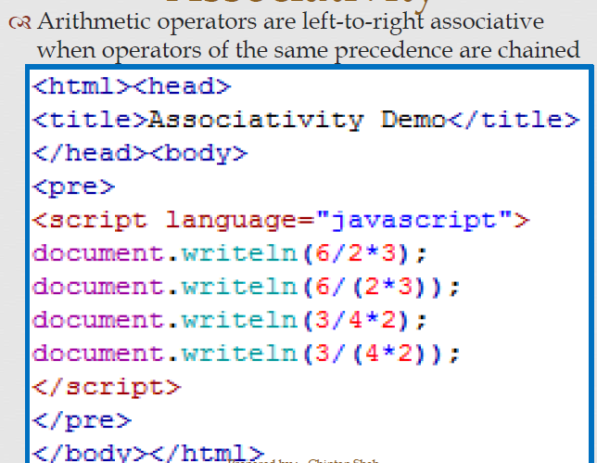
Associativity

Slide 43
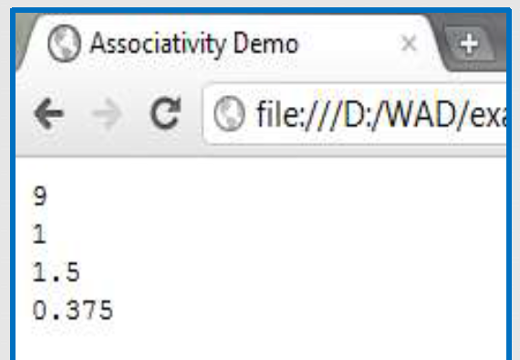
Output

Slide 44
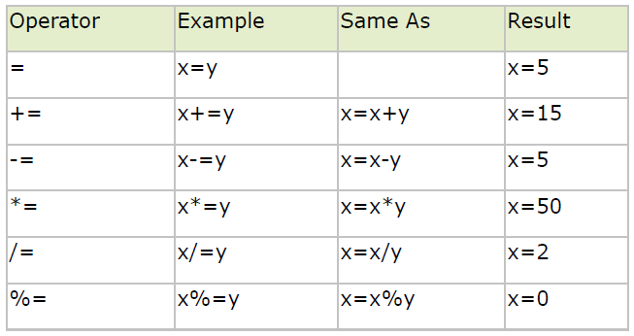
Assignment
Assignment operators are used to assign values to JavaScript variables.
Given that x=10 and y=5, the table below explains the assignment operators:

Slide 45
Concatenation
The + operator can also be used to add string variables or text values together.
txt1="What a very";
txt2="nice day";
txt3=txt1+txt2; // txt3=txt1+ “ “ + txt2;
“What a verynice day” or
“What a very nice day”

Slide 46
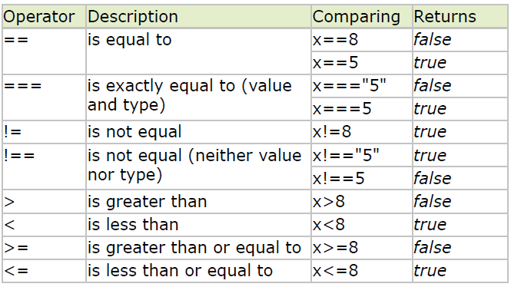
Comparison
Comparison operators are used in logical statements to determine equality or difference between variables or values.
Given that x=5, the table below explains the comparison operators:

Slide 47
Logical
Logical operators are used to determine the logic between variables or values.
Operator | Name | Description | Example
&& | Logical and | Evaluate to “true” when both operands are true | 3>2 && 5<2
|| | Logical or | Evaluate to “true when either operand is true | 3>1 || 2>5
! | Logical not | Evaluate to “true” when the operand is false | 5 != 3

Slide 48
Conditional
JavaScript also contains a conditional operator that assigns a value to a variable based on some condition.
Syntax
variablename=(condition)?value1:value2;
Example
max=(A>B)?“A is max":“B is max";

Slide 49
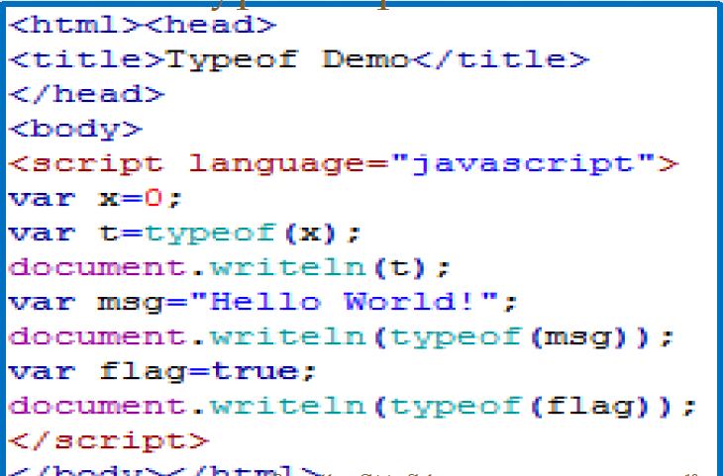
Typeof Operator

Slide 50
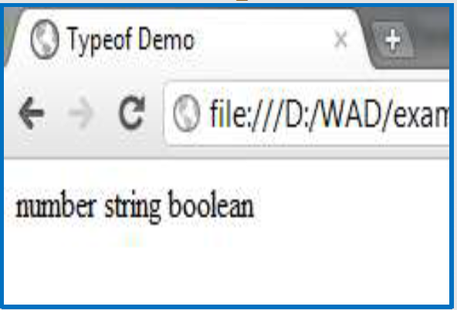
Output

Slide 51
Conditional Statements
if
if...else
if...else if....else
switch

Slide 52
Input and Output
The document.write property
For displaying message on the web browser this basic method is used.
With the content in “ ” inside the bracket.
document.write(“Computer Engineering”);
We can also pass the variable instead of string.
var branch=“Computer Engineering”
document.write(branch);
We can combine HTML, XHTML tag also,
var branch=“Computer Engineering”
document.write(“<b> “ + branch+”</b>”);

Slide 53
The Popup Boxes
Interactivity with browser by user.
3 types of Popup Boxes:
Alert Box: some message will be displayed
Confirm Box: message about confirmation will be displayed , hence it should have 2 buttons OK and Cancel.
Prompt Box: displays a text window in which the user can enter something.

Slide 54
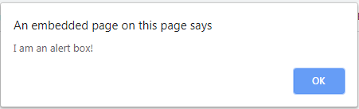
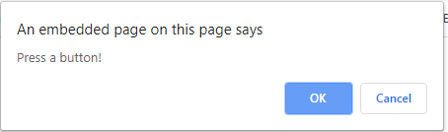
Alert Box
Confirm Box

Slide 55
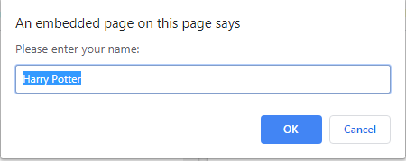
Prompt Box

Slide 56
Conditional Statements
Very often when you write code, you want to perform different actions for different decisions.
You can use conditional statements in your code to do this.
if statement - use this statement to execute some code only if a specified condition is true
if...else statement - use this statement to execute some code if the condition is true and another code if the condition is false
if...else if....else statement - use this statement to select one of many blocks of code to be executed
switch statement - use this statement to select one of many blocks of code to be executed

Slide 57
Conditional Statements
1. if statement:- Use the if statement to execute some code only if a specified condition is true.
Syntax :- if (condition)
{
code to be executed if condition is true
}
Example:- if (per>90)
{
distinction;
}

Slide 58
Cont’d..
2. if...else statement :- Use the if....else statement to execute some code if a condition is true and another code if the condition is not true.
Syntax:- if (condition)
{
code to be executed if condition is true
}
else
{ code to not be executed if condition is true
}

Slide 59
Cont’d..
Example
if (per>90)
{
document.write(“Distinction”);
}
else
{
document.write(“firstclass”);
}

Slide 60
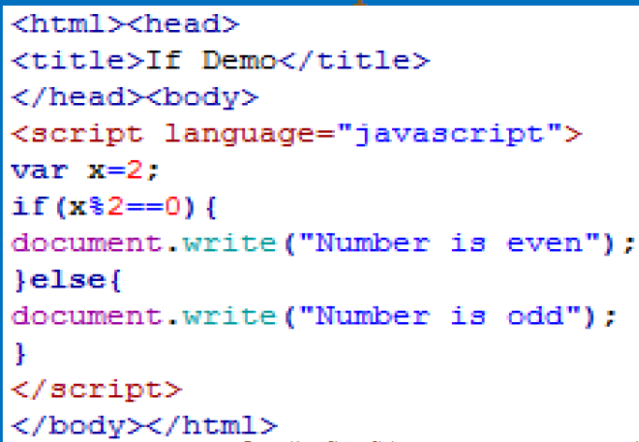
Example

Slide 61
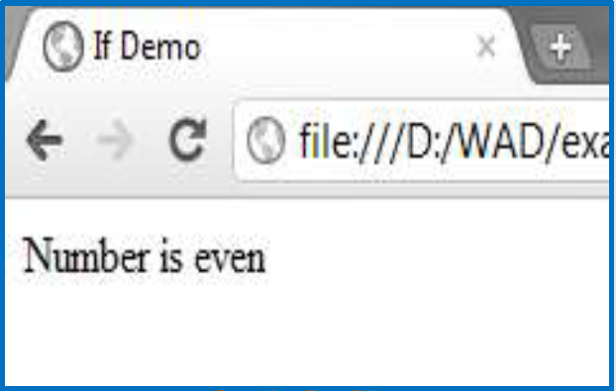
Output

Slide 62
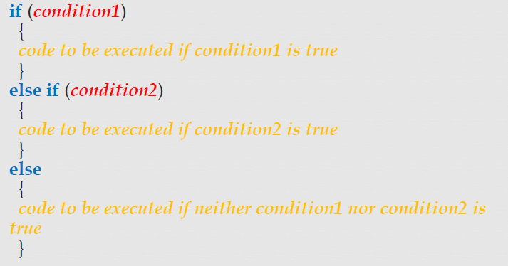
3. If..else…. If else….

Slide 63
Example
if (per>90)
{ document.write(“Distinction”); }
elseif (per>=90 && per<=75)
{document.write(“firstclass”); }
else
{document.write(“passclass”); }

Slide 64
4. Switch case Statement
4. Syntax:-
switch(n)
{
case 1: execute code block 1
break;
case 2: execute code block 2
break;
default: code to be executed if n is different from case 1 and 2
}

Slide 65
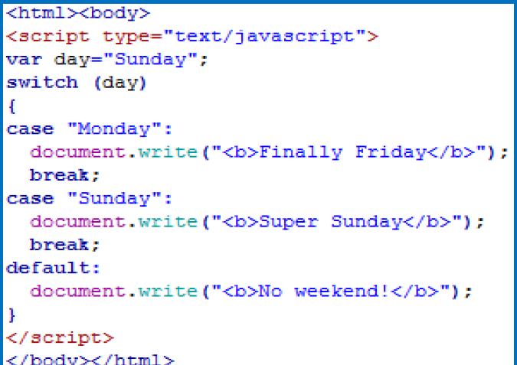
Example

Slide 66
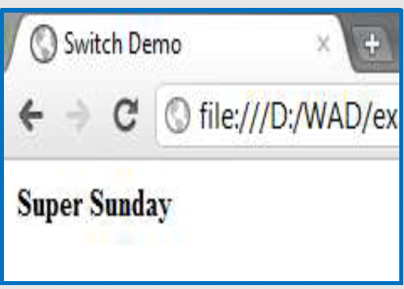
Output

Slide 67
Looping Statements
While Loop
Do… while Loop
For Loop

Slide 68
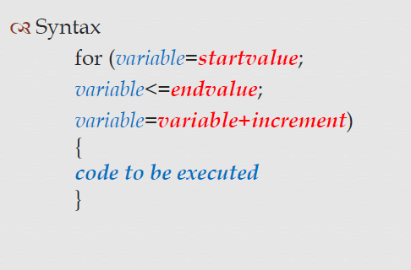
For Loop

Slide 69
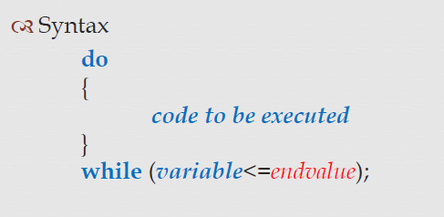
Do-While Loop

Slide 70
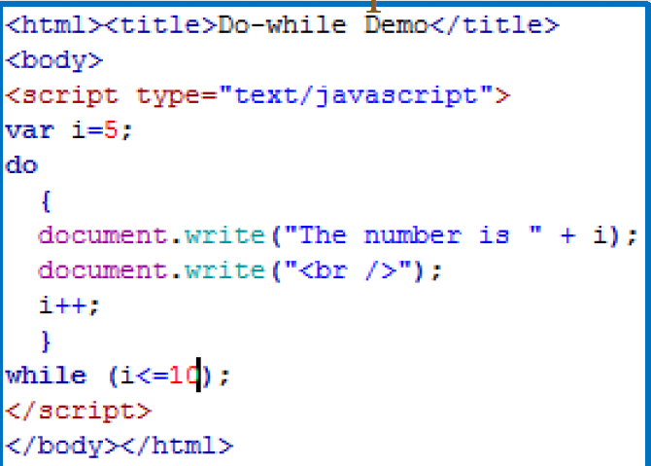
Example

Slide 71
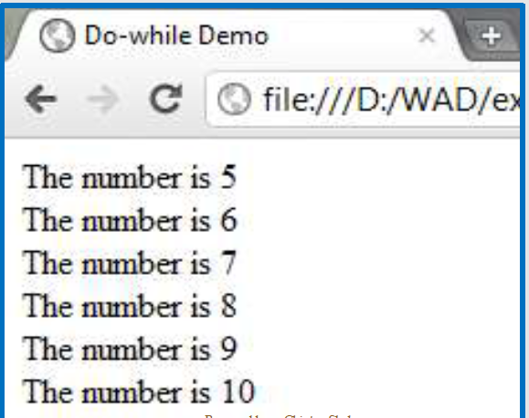
Output

Slide 72
Array Variable
An Array is a collection of data.
Each item in the array has an index to access it with and they begin at 0.
var a = [ele1, ele2,…..,elen];
Ex.
var num=[1,2,3,5];
Var color=[“red”,”blue”,”green”]
Var b=[true,false];
Var empty=[];
Access using array name & index.
Ex. Num[0]=1, b[1]=false,color[2]=green

Slide 73
Cont..
It may contain undefined elements.
Ex. var sub= [“WAD”, , ,“OOAD”, “CPU”];
Last comma will be ignored
Ex. var sub= [“WAD”, , ,“OOAD”, “CPU”,];
It can be displayed with the help of loop.
It may contain heterogeneous items in it.
Var person=[“ABC”, 25,false,20000];

Slide 74
Array Constructor
In JS an array is an object.
Provides constructors to create Array.
3 versions:
Array(); - does not take any arguments and create an empty array, elements can be added as an when created.
Ex. var color=new Array();
colors[2]=“blue”; what about elements at position [0] & [1] ?

Slide 75
Cont..
2. Array(no. of elements);
Ex. Color= new Array(3);
3. Array(Comma Separated list of elements);
Ex. var color = new Array(“red”,”blue”,”white”);
Array created with this way is called dense array.

Slide 76
Multi-Dimensional Array
Created same way as in 1-d .
in M-d array, elements are itself array.
Ex.
Var a=[1,3,5,7];
Var b=[2,4,6,8];
Var ab=[a,b];

Slide 77
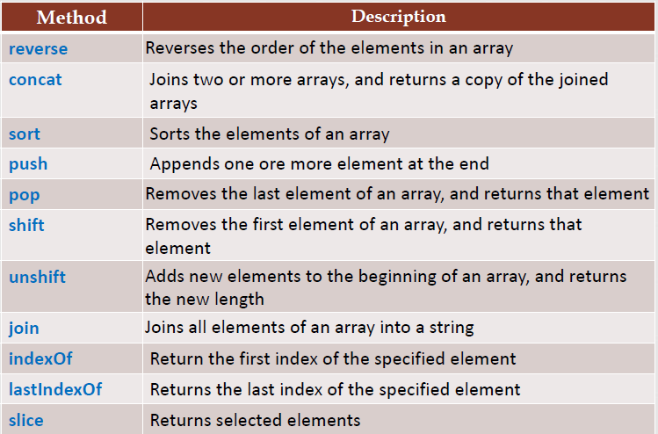
Array Methods-built in

Slide 78
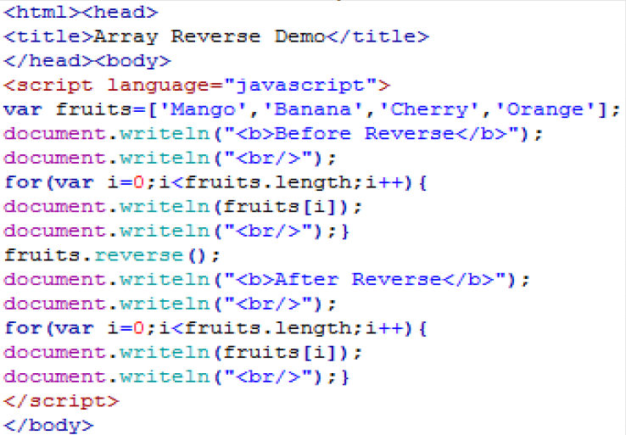
Array Reverse

Slide 79
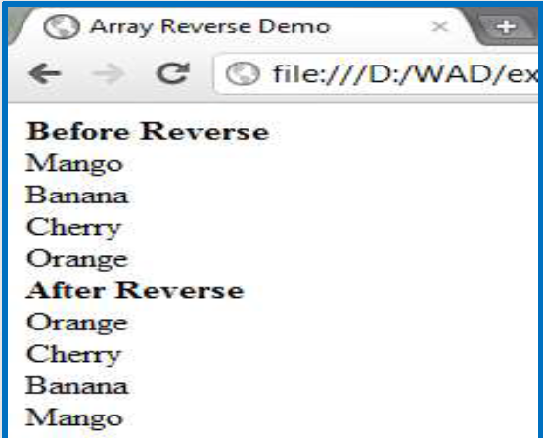
Output

Slide 80
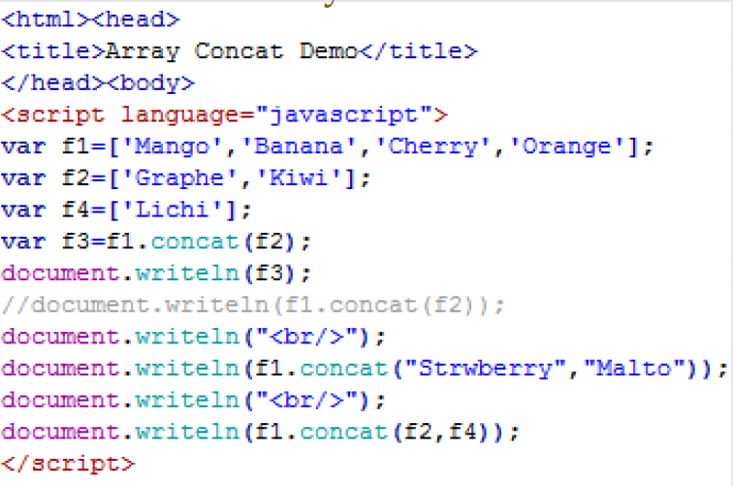
Array Concat….

Slide 81
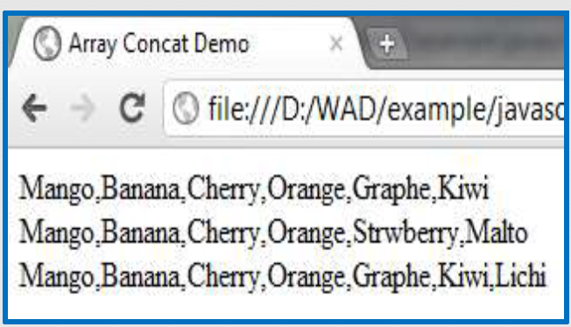
Output

Slide 82
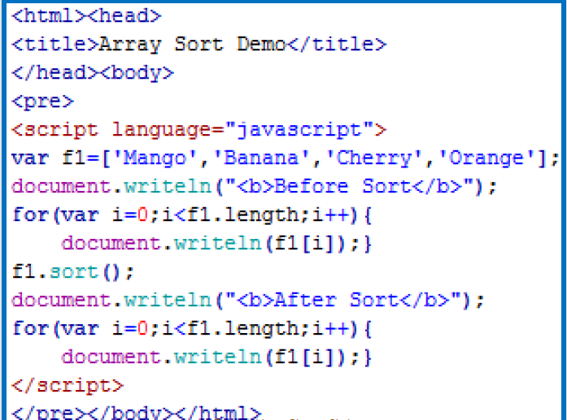
Array Sorting

Slide 83
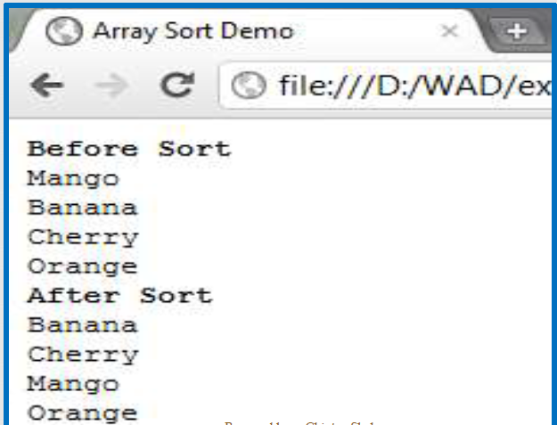
Output

Slide 84
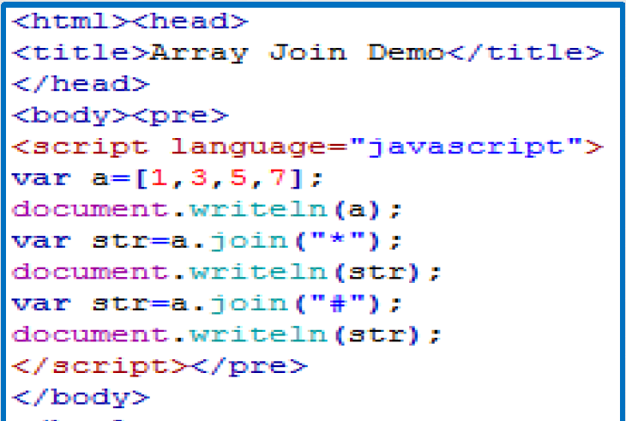
Array Join

Slide 85
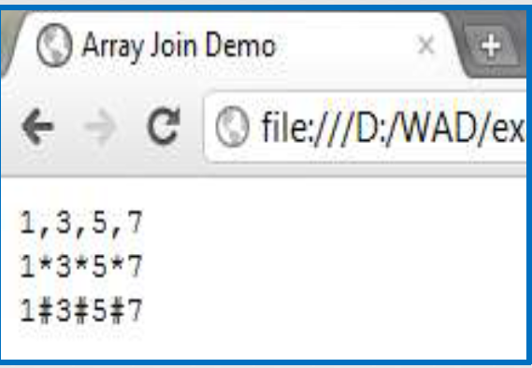
Output

Slide 86
Functions
It is a section of code that is separate from main program.
Defined once but can be invoked many times.
A function can be passed as parameters so that they can be used and a value can be returned back.
Many inbuilt functions are there.
Function is a datatype in itself.

Slide 87
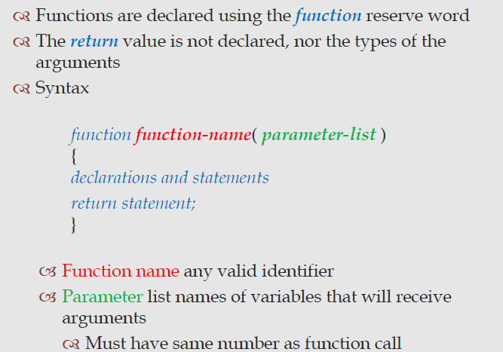
Function

Slide 88
Function Literal
var add=function(a,b)
{
Return (a+b);
}
This will have a reference of its variable name add.
This Function is same as following:
function add(a,b)
{ return a+b;}
It will be called with argument 4,5
var result=add(4,5);

Slide 89
Function Constructor
JS functions are objects called function objects.
Function objects can be created using the new operator:
new Function (arg1, arg2, ... argN, functionBody)
Ex:
var add=new Function (“a”,”b”,”return a+b”);
The Function constructor creates functions which execute in the global scope only.

Slide 90
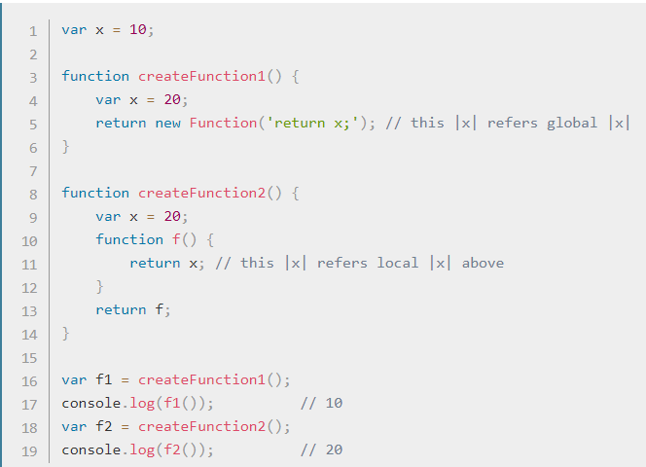

Slide 91
Objects
An object is a collection of named values and associated methods.
The named values are usually known as properties/fields
Ex. Any physical object car – has color, model no. brand, mfg. year, etc..
To refer an object’s property we use:
objectRef.propertyname
objectRef- name of the object (can also be the name of of a variable that an object has been assigned to)
Propertyname- property of the object.

Slide 92
User Defined Objects-literals
Easiest & straightforward way .
Objname={property1:value1,…..propertyn:valuen}
P={x:2,y:3};
P.color=“red”;
Var Student={name:abc,no=1,college=svbit,marks:[20,30]};

Slide 93
Object
<!DOCTYPE html>
<html>
<body>
<p>Creating a JavaScript Object.</p>
<p id="demo"></p>
<script>
var person = {
firstName: "John",
lastName: "Doe",
age: 50,
eyeColor: "blue"
};

Slide 94
document.getElementById("demo").innerHTML = person.firstName + " is " + person.age + " years old.";
</script>
</body>
</html>

Slide 95
Creating a JavaScript Object.
John is 50 years old.

Slide 96
Constructor
<script>
Function person(name,age)
{ this.name=name;
this.age=age;
}
Var person1 = new person(“abc”,20);
document.write(person1.name+person1.age);
</script>

Slide 97
Built in objects
Date
String
Math

Slide 98
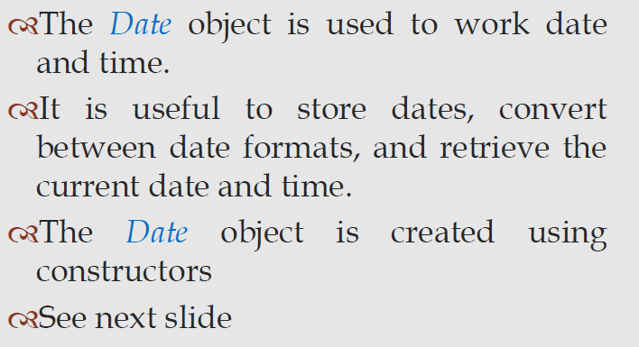
Date Object

Slide 99
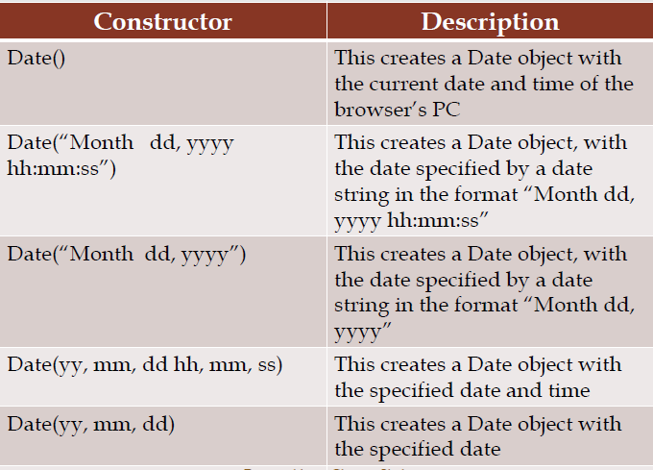
Date

Slide 100
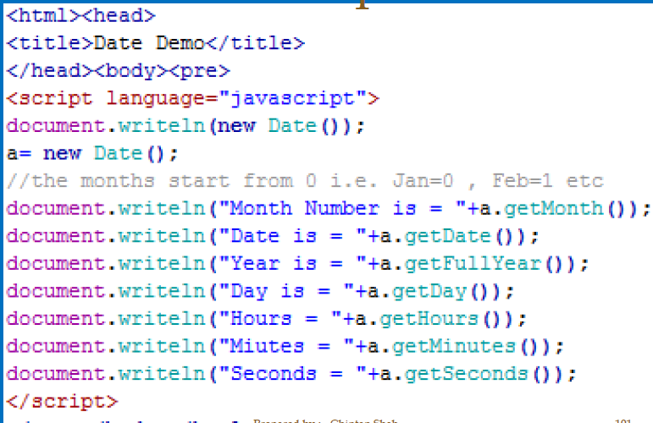
Example

Slide 101
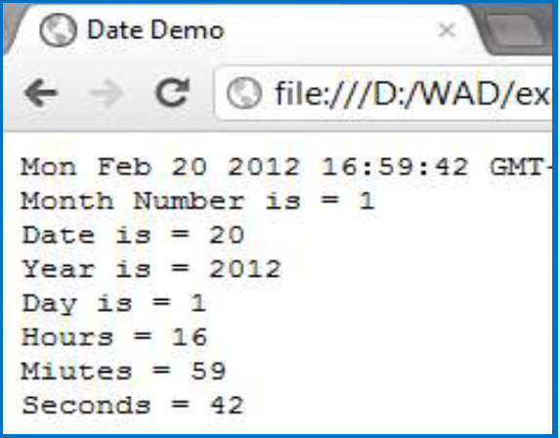
Output

Slide 102
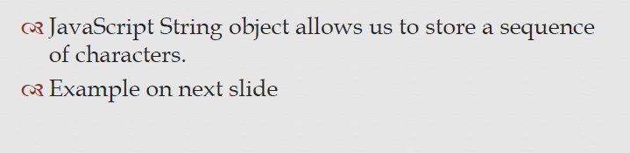
String Object

Slide 103
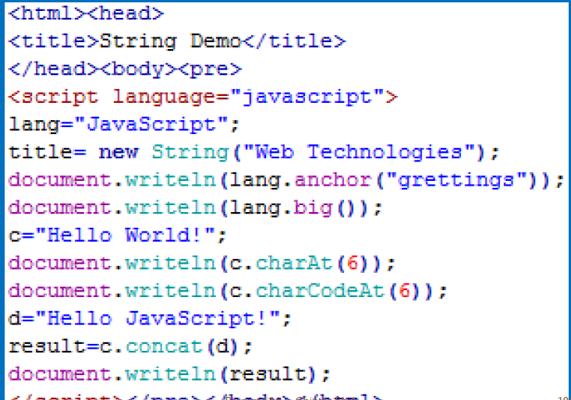
Example

Slide 104
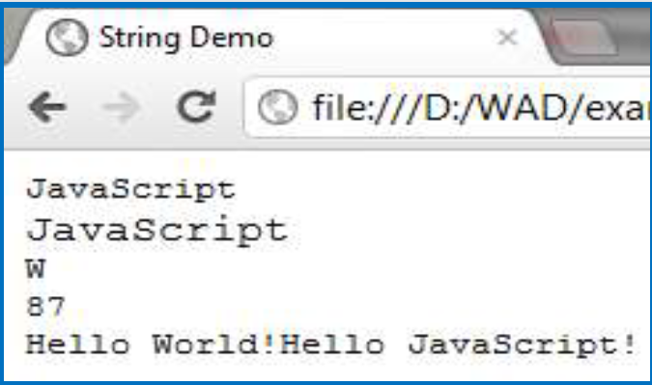
Output

Slide 105
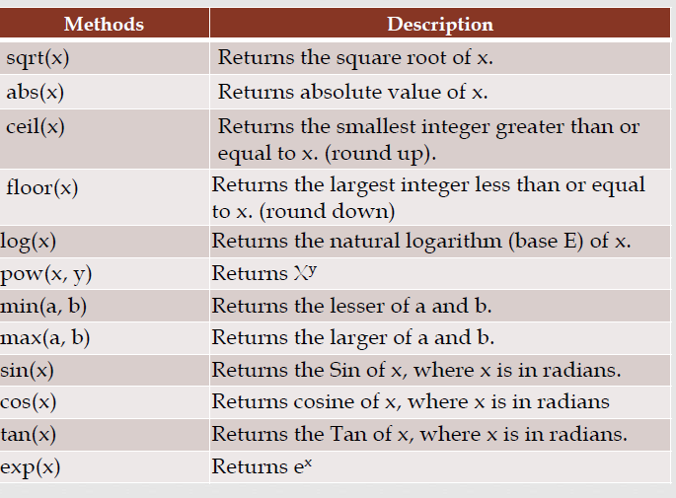
Math

Slide 106
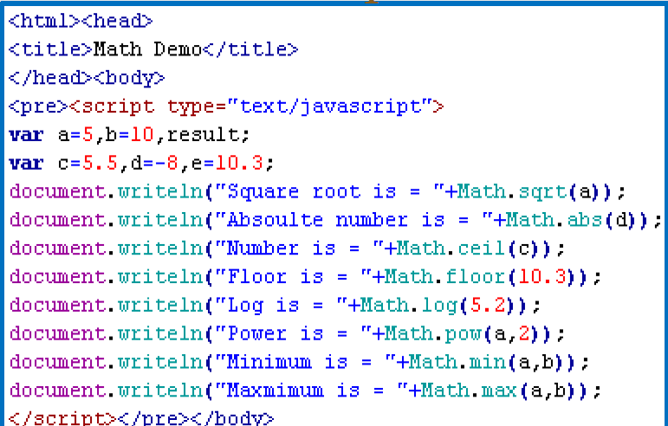
Example

Slide 107
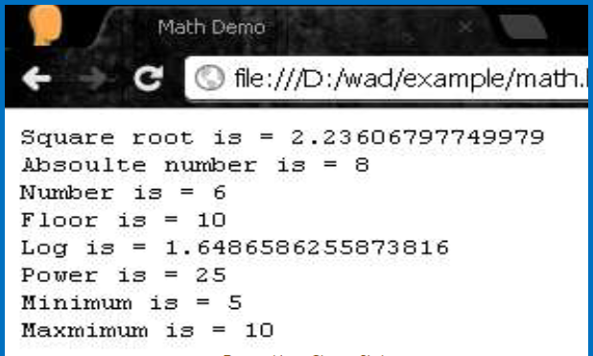
Output

Slide 108
Document Object Model
When a web page is loaded, the browser creates a Document Object Model of the page.
JavaScript arranges objects in a Document Object Model or DOM.
The components of web pages are represented by objects that are organized into hierarchical manner, called DOM.
The hierarchical structure is represented as parent-child relationship.
Top of the object hierarchy is Window object- which represents the entire browser window that displays the document.

Slide 109
A Part of the Document Object Model
This figure shows a section of the entire Document Object Model (DOM).
The full DOM would be a much larger figure.
window
frame
event
history
document
location
navigator
screen
anchor
form
image
link
style
tag
button
checkbox
input
radio
reset
select
submit
textarea

Slide 110
DOM Hierarchy
The topmost object in the hierarchy is the window object, which contains the other objects in the list, such as the current frame, history list, and the Web page document.
The Web page document contains its own set of objects, including links, anchors, and forms.
Within each form are form objects, such as input boxes, radio buttons, or selection lists.

Slide 111
Object Names and Browsers
Include the DOM hierarchy when referring to an object
i.e document.write(“Hello World”);
It is actually like this:
window.document.write(“Hello World”);
Some browsers cannot interpret the object names without the complete hierarchy.

Slide 112
What is the DOM?
The DOM is a W3C (World Wide Web Consortium) standard.
The DOM defines a standard for accessing documents:
"The W3C Document Object Model (DOM) is a platform and language-neutral interface that allows programs and scripts to dynamically access and update the content, structure, and style of a document."
The W3C DOM standard is separated into 3 different parts:
Core DOM - standard model for all document types
XML DOM - standard model for XML documents
HTML DOM - standard model for HTML documents

Slide 113
DOM
According to the DOM, everything in an HTML
document is a node.
The DOM says:
The entire document is a document node
Every HTML element is an element node
The text in the HTML elements are text nodes
Every HTML attribute is an attribute node
Comments are comment nodes

Slide 114

HTML DOM

Slide 115


Slide 116


Slide 117


Slide 118


Slide 119


Slide 120


Slide 121


Slide 122


Slide 123
Working with Object Properties
Each object in JavaScript has properties associated with it.
The number of properties depends on the particular object; some objects have only a few properties, while others have many.
As with object names, certain keywords identify properties.

Slide 124


Slide 125
Properties

Slide 126


Slide 127
Method

Slide 128


Slide 129
The document Object
Using this object it is possible to control certain aspects of the current document like background, foreground & link colors.
Document.bgcolor=“008000”;
Document.fgcolor=“#FAF159”;
Document.linkcolor=“red”;
Document.write(“hello there”);
Document.write(“<a href=“jsdemo.html”> JSDemo </a>”);

Slide 130
Resize window

Slide 131
<!DOCTYPE html>
<html><head><script>
var w;
function openwindow()
{
w=window.open('','', 'width=100,height=100');
w.focus();
}
function myFunction()
{
w.resizeTo(1000,1000);
w.focus();
}
</script></head><body>
<button onclick="openwindow()">Create window</button>
<button onclick="myFunction()">Resize window</button>
</body></html>

Slide 132


Output

Slide 133
Example- to access form fields
Ex. A form can be constructed with
<form name="userDetails" onSubmit="processForm()">
Enter First Name:<input type="text“ name="fname"/> <br>
Enter Last Name :<input type="text" name="lname"/> <br>
<input type="submit" name="submit"/>
</form>

Slide 134
Cont..
Form can be accesed
document.formname
Individual elements can be accessed with,
document.userDetails.fname.value

Slide 135
Forms & Validation
HTML form validation can be performed automatically by the browser.
Form validation is the process of making sure that data supplied by the user using a form, meets the criteria set for collecting data from the user.
For example, if you are using a registration form, and you want your user to submit name, email id and address, you must use a code (in JavaScript or in any other language) to check whether user entered a name containing alphabets only, a valid email address and a proper address.

Slide 136

Example

Slide 137


Slide 138
Using Regular Expression for Validation
R.E.- sequence or pattern of characters that specifies a rule.
Regular expression become powerful tools for data validation.
Used to check data against a pattern or a rule very easily.
Typically used in web page to verify the input supplied by the user before sending it to the server.

Slide 139
R.E in JS
var exp=/pattern/;
Start with ^ , ends with $- known as meta characters
\d- digits, \w- alphanumeric,
+ means 1 or more occurrence
* means 0 or more occurrence
? means 0 or 1 occurrence
{n} means exactly n occurrence
{n,m} means range
Methods:
exec(),Match(),Test(),Search(),Replace(), Split()

Slide 140
Ex. of Reg. Exp.
^\w{6,8}$- match any string having 6 -8 alphanumeric
^\d{1,2}$ - any no. from 0-99
All length
(pass_len==0 || pass_len>=min|| pass_len<=max)
All letter - /^[A-Za-z]+$/
Alphanumeric - /^[0-9a-zA-Z]+$/
All numeric - /^[0-9]+$/
Match a JS Date- ^\d{2}\-\d{2}\-\d{4}$
Phone no.- ^\d{2}\-\d{3}\- \d{7}$

Slide 141
Validating data
<form name=“register”>
Enter Username: <input type=“text” name=“uname”/>
<input type=“submit” value=“submit” onClick=check() /> </form>
function check()
{ var name= /^[a-zA-Z]+$;
If(!(name.test(register.uname.value))
{ alert(“enter proper name”);
return false;}
Else return true;

Slide 142
Event
Basic purpose of JS is to provide interactivity to web pages.
It can be provided by responding to the user actions.
i.e. whenever user performs some tasks, it reacts by executing some piece of code.
The set of tasks that users may perform on a web page are called interactive events or simply events.
Ex. User clicks on a button, click event occurs.
Button is called source of the event.
Other ex. Mouse over link(mouseOver event),Form Submit event keystroke (keypress event), mouseDown event,so on…….

Slide 143
Event Handlers
JavaScript identifies an event and takes an action by executing some piece of code.
The procedure of taking actions is called event handling.
The specific JS code that handles the event is called, event handler.
It can be any valid JS statements. Usually as functions.
Event handler may be interactive or non-interactive, depending upon the type of event it handles.
JS identifies the event & executes its handler.
Event works as a trigger, and handler is triggered by the event.

Slide 144
Syntax
The handler of the event for some element is specified by assigning it to the property of the element.
Ex. onEvent
For click event- onClick
Mouse over- onMouseOver

Slide 145

Cont…

Slide 146


Slide 147


Slide 148
Window Events
onLoad-new page is starting up
onUnload- current page is closing
onResize- being resized
onMove- being moved
onAbort – cancel

Slide 149


Slide 150


Slide 151


Slide 152
DHTML
Dynamic HTML, or DHTML, is an umbrella term for a collection of technologies used together to create interactive and animated web sites by using a combination of a static markup language(such as HTML), a client-side scripting language (such as JavaScript), a presentation definition language (such as CSS), and the Document Object Model.

Slide 153
The image object
By associating an image and an Image object it is possible to control images better using caching.
Image object is created
anImage=new Image();
anImage.src=“abc.jpg”;
Properties of image:
Border, complete,height,hspace,lowsrc, name, src, vspace, width

Slide 154


Slide 155
Controlling your browser
The window has some useful features that can use to control browser.
Ex. To open a new window without disturbing the current window content.
mywindow=window.open(“js2.html”,”jsdemo”,”width=500,height=300,scrollbars=yes”);

